Slide 1


Slide 2
Automatic Performance Diagnosis and Tuning in Oracle 10g
Graham Wood
Graham.Wood@oracle.com
Oracle Corporation

Slide 3
Agenda
Problem Definition
Tuning Goal: Database Time
Workload Repository
ADDM: Performance Tuning
Conclusion

Slide 4
DBA May Ask:
How can I make the application go faster?
How can I make the database server do less work for the same application workload?
(I.e., how can I increase capacity with/without adding hardware?)
How can I improve response time for a specific user?

Slide 5
Traditional Performance Tuning Methodology
Performance and Workload Data Capture
  System Statistics, Wait Information, SQL Statistics, etc.
Analysis
  What types of operations database is spending most time on?
  Which resources is the database bottlenecked on?
  What is causing these bottlenecks?
  What can be done to resolve the problem?
Problem Resolution
  If multiple problems identified, which is most critical?
  How much performance gain I expect if I implement this solution?

Slide 6
Problem Definition
Performance Diagnosis & Tuning is complex
Needs in-depth knowledge of database internals
Lack of good performance metric to compare database components
Data capture too expensive, too high level requiring workload reply
Misguided tuning efforts waste time & money

Slide 7
Agenda
Problem Definition
Tuning Goal – Database Time
Performance Tuning: ADDM
The Workload Repository
More Complex Models
Conclusion

Slide 8
Database Time (DB Time)
Time spent by user sessions in database calls
DB Time / Wallclock time similar to Load Average
Only a portion of the User Response Time
Other components:
  Browser
  Network latency (WAN and LAN)
  Application server
Often > 100% of elapsed time
  Multiple sessions
  Parallel operations by a single session

Slide 9
DB time
Checkout using
‘one-click’
User Response Time
Browser
WAN
APPS
Server
LAN
DB Time
LAN
APPS
Server
WAN
Browser

Slide 10
DB Time:
Example for One Session
Query for Melanie Craft Novels
Browse and
Read
Reviews
Add
item to cart
Checkout using
‘one-click’
DB Time

Slide 11
The Simple Computation Model
One “Process” per user connection
Process state may be:
  On CPU
  Waiting for a resource
    Hardware resource (like I/O, CPU)
    Software resource (like LOCK)
  Idle (not part of DB time)
    Waiting for user command

Slide 12
The Simple Computation Model
User 1
User 2
User 3
User n
The Parts of DB Time
Wait
CPU

Slide 13
DB Time: Common Currency
Measurement of work done by the server while users are waiting for results
Each database component is analyzed using its contribution to database time.
Tuning goal – reduce DB time

Slide 14
Agenda
Problem Definition
Tuning Goal – Database Time
Workload Repository
ADDM: Performance Tuning
Conclusion

Slide 15
Automatic Workload Repository (AWR)
Data to quantify the impact (in database time) of various database components
Data to find root cause and suggest remedies.
Gather data all the time so we can give “first occurrence” analysis
Non-intrusive, lightweight

Slide 16
How AWR Works
System instrumented to provide all needed statistics
Data captured by hourly snapshots out-of-the-box.
Data is stored in tables called “the workload repository”
Most data is cumulative so can compare any pair of snapshots

Slide 17
Types of Data in AWR
Database-time spent in various events/resources
Usage statistics (counts of occurrences)
Operating system resource usage
System configuration
Simulation data (what-if scenarios)
Sampled data (Active Session History)

Slide 18
Simulation data
Some system components are best analyzed through online simulations.
  E.g. Buffer Cache Size
Simulations for various settings are run as part of normal system work.
Estimate the effect of each setting on database time.
We recommend the best setting based on cost and benefit in database time.

Slide 19
Sampled Data:
Active Session History (ASH)
Samples active sessions every second into memory
Direct access to kernel structures
Selected samples flushed to AWR
Data captured includes:
  Session ID
  SQL Identifier
  Application Information
  CPU / Wait event
  Object, File, Block being used at that moment
  (Many more Oracle specific items)
Fine Grained fact table allows detailed analysis

Slide 20
Active Session History (ASH)
Query for Melanie Craft Novels
Browse and
Read
Reviews
Add
item to cart
Checkout using
‘one-click’
DB Time

Slide 21
Active Session History (ASH)
Query for Melanie Craft Novels
Browse and
Read
Reviews
Add
item to cart
Checkout using
‘one-click’
DB Time
Time
SID
Module
SQL ID
State
Event
7:38:26
213
Book by author
qa324jffritcf
WAITING
db file sequential read
7:42:35
213
Get review id
aferv5desfzs5
CPU
7:50:59
213
Add to cart
hk32pekfcbdfr
WAITING
buffer busy wait
7:52:33
213
One click
abngldf95f4de
WAITING
log file sync

Slide 22
Agenda
Problem Definition
Tuning Goal – Database Time
Workload Repository
ADDM: Performance Tuning
Conclusion

Slide 23
ADDM Design Highlights
Database-wide performance diagnostics
Data from AWR
DB Time as a common currency and target
Throughput centric top-down approach
Root Cause analysis
Problems/Findings with impact
Recommendations with benefit
Identify “No-Problem” areas

Slide 24

ADDM Architecture
Automatic Diagnostic Engine
Automatic Diagnostic Engine
Classification tree based on decades of Oracle performance tuning expertise
Each Node looks at DB Time spent on a specific issue
  Node’s DB Time is fully contained in its parent
DB Time based drilldowns
  Branch Nodes => Symptoms
  Leaf Nodes => Problems (Root cause)

Slide 25
Two Views of DB Time Breakdown
Root
Parse
Conn Mgmt
Concurrency
CPU
Java Exec
PLSQL Exec
User I/O
Application
SQL Exec
Top level nodes
Phases of Execution
  Connection Management (logon, logoff)
  Parse (hard, soft, failed,..)
  SQL, PLSQL and Java execution times
CPU and Wait Model
  CPU
  800+ different wait events
  12 wait classes

Slide 26
ADDM Methodology
Problem classification system
Decision tree based on the database-time breakdowns
……
……
Buffer Busy
CPU
CPU/Wait Model
Parse Latches
……
Concurrency
Buf Cache latches
User I/O
Symptoms
Root Causes

Slide 27
ADDM Methodology
Problem classification system
Decision tree based on the database-time breakdowns
……
……
Buffer Busy
CPU
CPU/Wait Model
Parse Latches
……
Concurrency
Buf Cache latches
User I/O
Non - Problems areas.

Slide 28
What ADDM Diagnoses (1)
Physical Resources
CPU issues
  capacity, run-queue, top SQL
I/O issues
  capacity and background, top SQL, top objects, memory components, log file performance
Insufficient size of memory components
  buffer caches, other shared/private components
Network issues

Slide 29
What ADDM Diagnoses (2)
Server (Software) Resources
Application contention
  Application induced contention e.g table/user/row locks
Concurrency issues
  Internal contention (e.g. internal locks)
Configuration issues
  log file size, recovery settings
Cluster issues

Slide 30
What ADDM Diagnoses (3)
Phases of Execution
Connection management
Parsing
  Compilation and shared-plans issues
Execution phase
  PL/SQL execution, JAVA execution, SQL execution
Top SQL by DB-Time

Slide 31
Types of Findings
PROBLEM
  Root cause for a performance issue
SYMPTOM
  Provides inference path to root causes
WARNING
  Incomplete snapshots, deprecated or unsupported configuration (e.g., rollback segments)
INFORMATION and NO-PROBLEM
  Areas the DBA should not try to tune. Other
  informational messages.

Slide 32
Types of Recommendations
Hardware issues
  Add CPUs, stripe files
Application changes
  Use connection-pool instead of connect-per-request
Schema changes
  Hash partition an index
Server configuration changes
  Increase buffer cache size
Use SQL Tuning Advisor
  Missing index / stale statistics / other optimizer issues
Use Other Advisors

Slide 33
Agenda
Problem Definition
Tuning Goal – Database Time
Performance Tuning: ADDM
The Workload Repository
More Complex Models
Conclusion

Slide 34
Background Activity
Background is not part of database time
Foreground Sessions
  User Requests
  User scheduled jobs, replication target
Background Sessions
  Most write I/O (in Oracle)
  Maintenance jobs

Slide 35
Parallel Computation
A parallel computation consists of a coordinator session and slave sessions (processes)
The user waits for the query coordinator session
All sessions accumulate database time, and the sum of database time is charged for the parallel query
A parallel computation is a trade-of between total throughput and response time.

Slide 36
Distributed System
Oracle uses a “shared disk” architecture
Database time of all nodes (machines) is added for a total cost on the system.
Some database components can only be tuned at the cluster level
  I/O (because of shared disk)
  Network (always shared)
  Buffer caches (because of “cache-fusion”)
Single user request can span multiple nodes

Slide 37
Agenda
Problem Definition
Tuning Goal – Database Time
Performance Tuning: ADDM
The Workload Repository
More Complex Models
Conclusion

Slide 38
Simple Idea
First: Find a tuning goal that unifies all database activity and components
Second: Drill down from generic components to specific issues affecting the system
Always: Experts that know system internals are rare and expensive. Automate their task as much as possible.

Slide 39
Problem Solution
Instrumentation in RDBMS provides usage statistics
AWR provides lightweight, always on, data collection
ADDM analyzes data in AWR
  holistic time based analysis
  compares impact across components (unifying performance metric)
  in-depth knowledge of database internals
  reports top problems and solutions
  reports non-problem areas to avoid wasted efforts
Positive feedback both internally and from customers

Slide 40
Problem Solution: ADDM
In-depth knowledge of database internals
  automated problem diagnosis
Database wide view of operations is lacking
  holistic time based analysis
  compares impact across components (unifying performance metric)
Data overload rather than information
  reports top problems and solutions
Misguided tuning efforts
  reports non-problem areas

Slide 41
Q
&
A
Q U E S T I O N S
A N S W E R S

Slide 42
Contact Information
For hiring questions and sending resumes:
satarupa.bhattacharya@oracle.com
For hiring to the manageability and diagnoseability groups:
uri.shaft@oracle.com

Slide 43
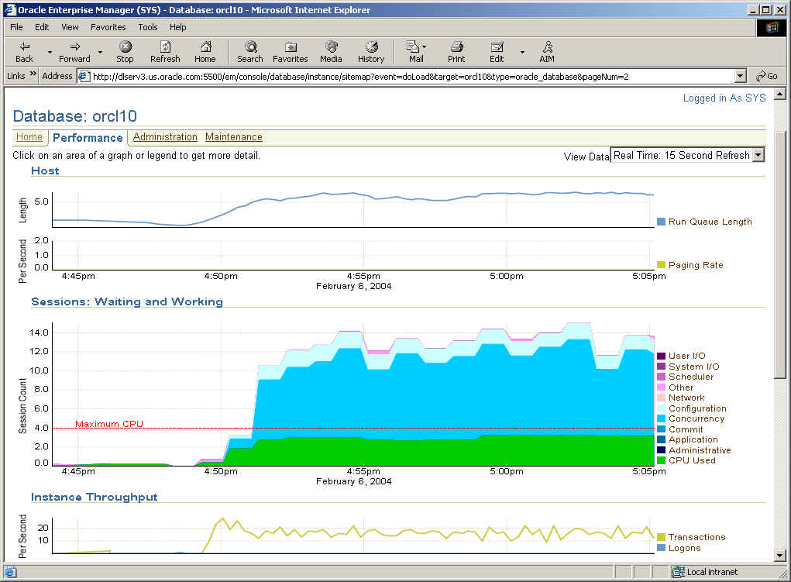
With Oracle 10g and Diagnostics Pack….
System is maxed out on CPU with most waits in the concurrency wait class.

Slide 44
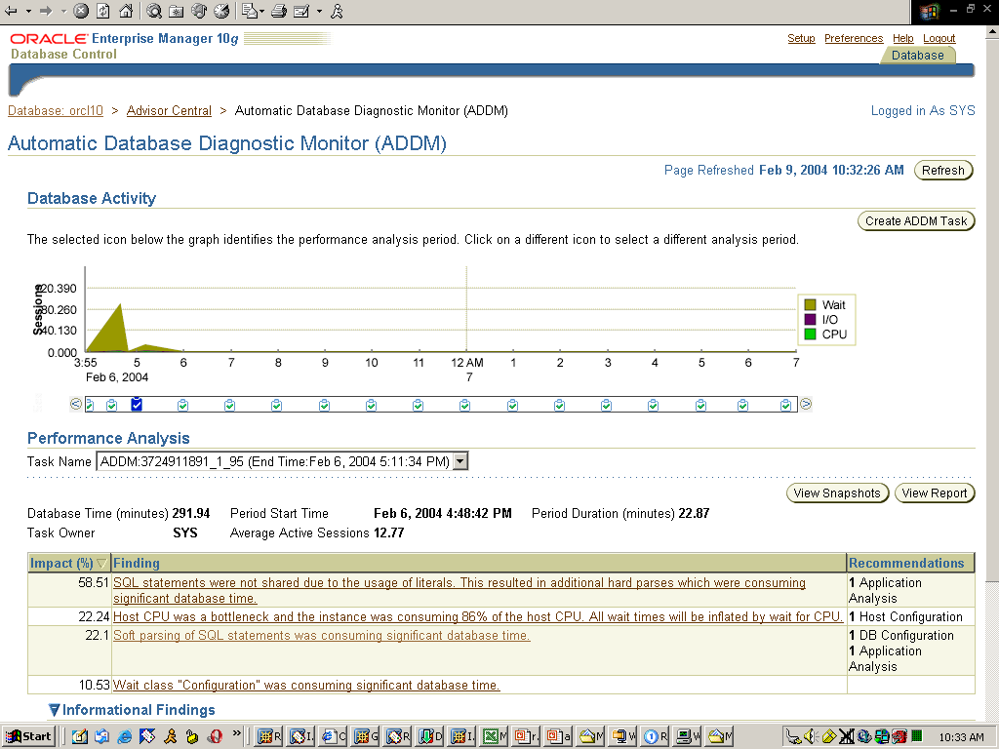
ADDM Findings
ADDM has automatically identified that high CPU utilization was caused by repeated hard parses ……

Slide 45
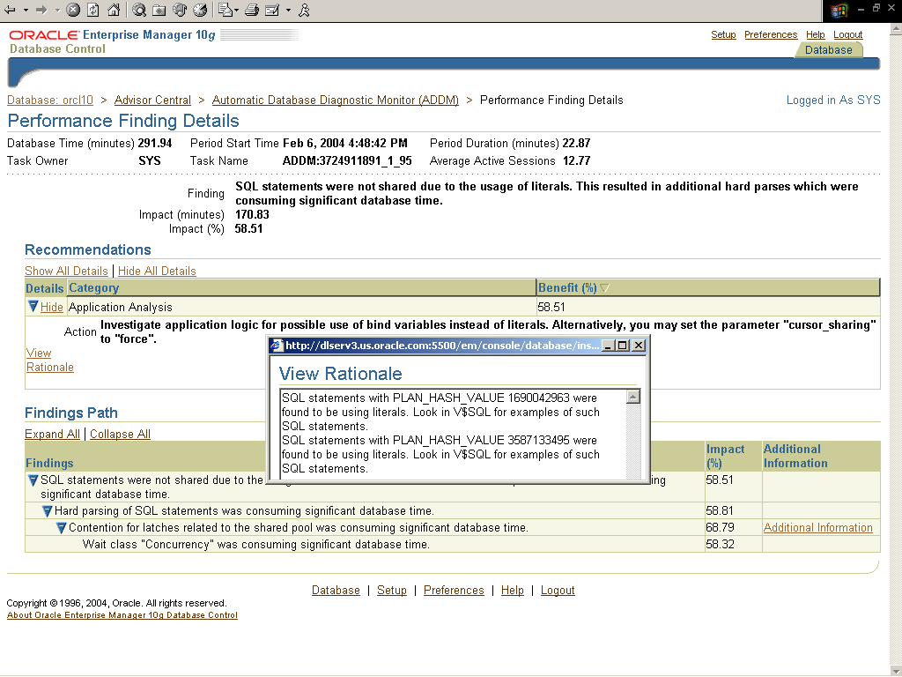
ADDM Findings
…and recommends solution as well explain how it diagnosed the problem

Slide 46
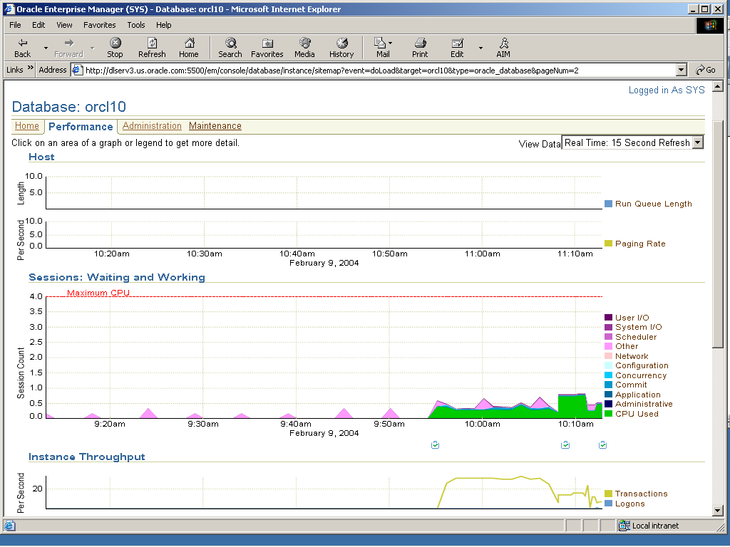
Good Performance Page
Once the solution is applied, CPU utilization falls dramatically
..and waits disappeared

Slide 47
Life Before and After ADDM
Scenario: Hard parse problems
Before
Examine system utilization
Look at wait events
Observe latch contention
See waits on shared pool and library cache latch
Review v$sysstat
See “parse time elapsed” > “parse time cpu” and #hard parses greater than normal
Identify SQL by..
  Identifying sessions with many hard parses and trace them, or
  Reviewing v$sql for many statements with same hash plan
Examine and review SQL
Identify “hard parse” issue by observing the SQL contains literals
Enable cursor sharing
Oracle10G
Review ADDM recommendations
ADDM recommends use of cursor_sharing
Notes:
The “head” image depicts a decision point.

Slide 48


ADDM Analysis
Can do manual ADDM analysis
MMON Slave
(m00*)
Advisor Framework
AWR
EM or
addmrpt.sql
ADDM
using
DBMS_ADVISOR
9 am
10 am
11 am
12 pm
1 pm

